Slide 1


ECEN 403 Final Presentation Team #38 Fuel Cell Monitor Rana Kortam Jessica Odutola Sameer Osama Russell Wells John Lusher

Slide 2
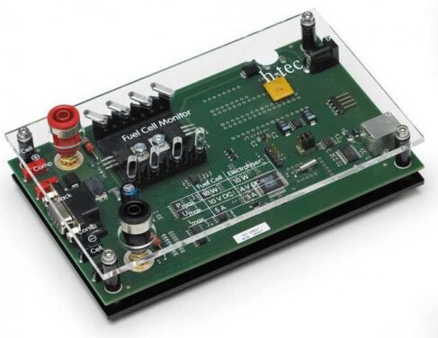
Project description
Problem statement: A single fuel cell is an easy power source to monitor, but to achieve any level of real usable power they must be connected in a stack. The goal of this project is to design a monitor that displays individual cell voltages within a stack and warns the user of cell abnormalities as well as which cell requires maintenance or attention.

Slide 3
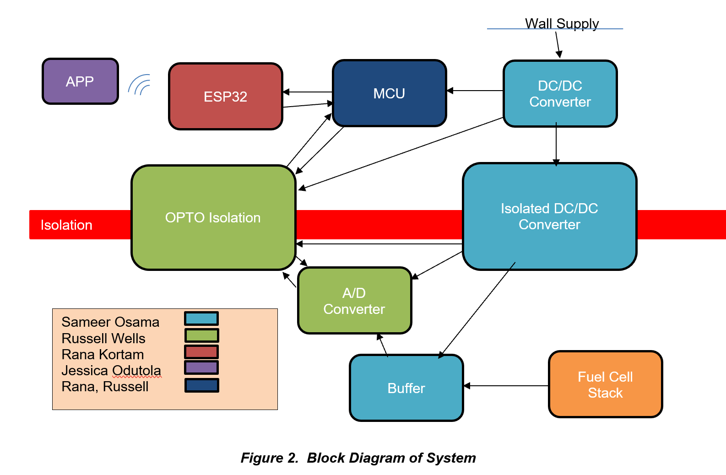
Diagram of subsystems and interface

Slide 4
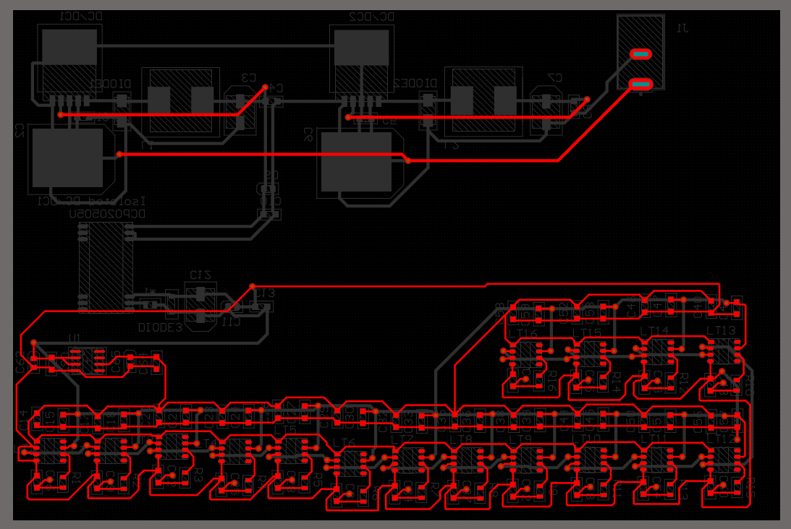
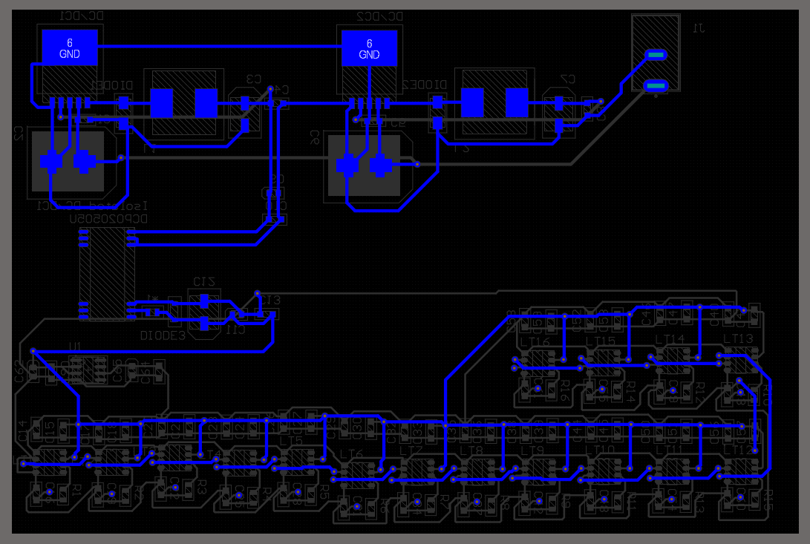
403 Deliverables (Power Supply)
Design PCB in Altium
Order PCB and solder components
Test output voltages
Top Layer
Bottom Layer

Slide 5
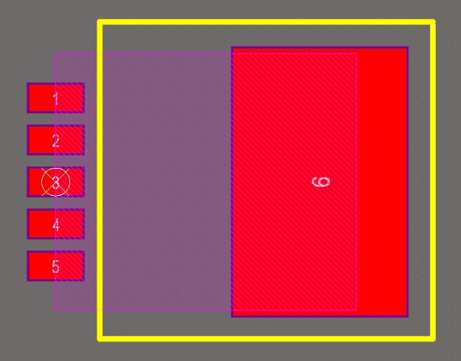
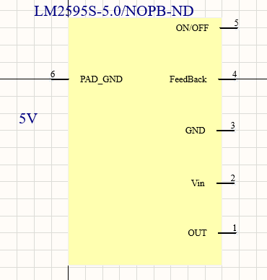
Challenges (Power Supply)
Learning how to make schematics and footprints
Using a new software (Altium)
Figuring out what specific parts to order

Slide 6
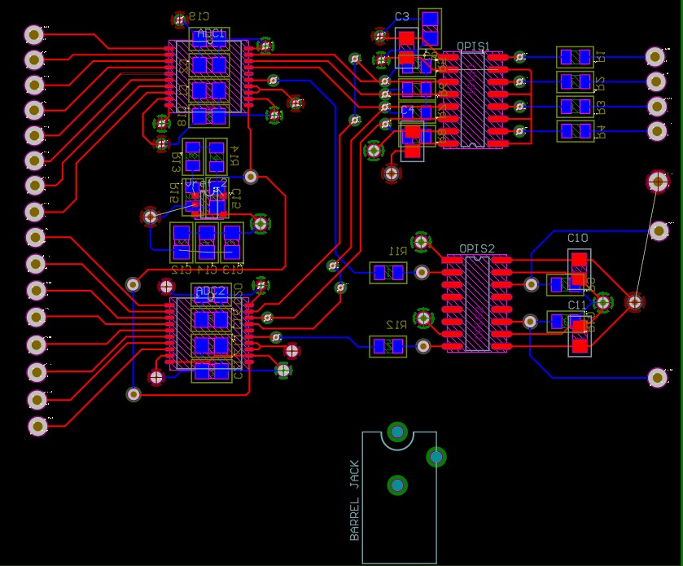
Internal Data Transfer and Manipulation Deliverables
Create PCB Design.
Create Breadboard Test Circuit
Confirm Isolator Circuit’s Ability To Pass Digital Information. (Fail)
Confirm Isolator Circuit’s Ability to Control ADC. (Fail)

Slide 7
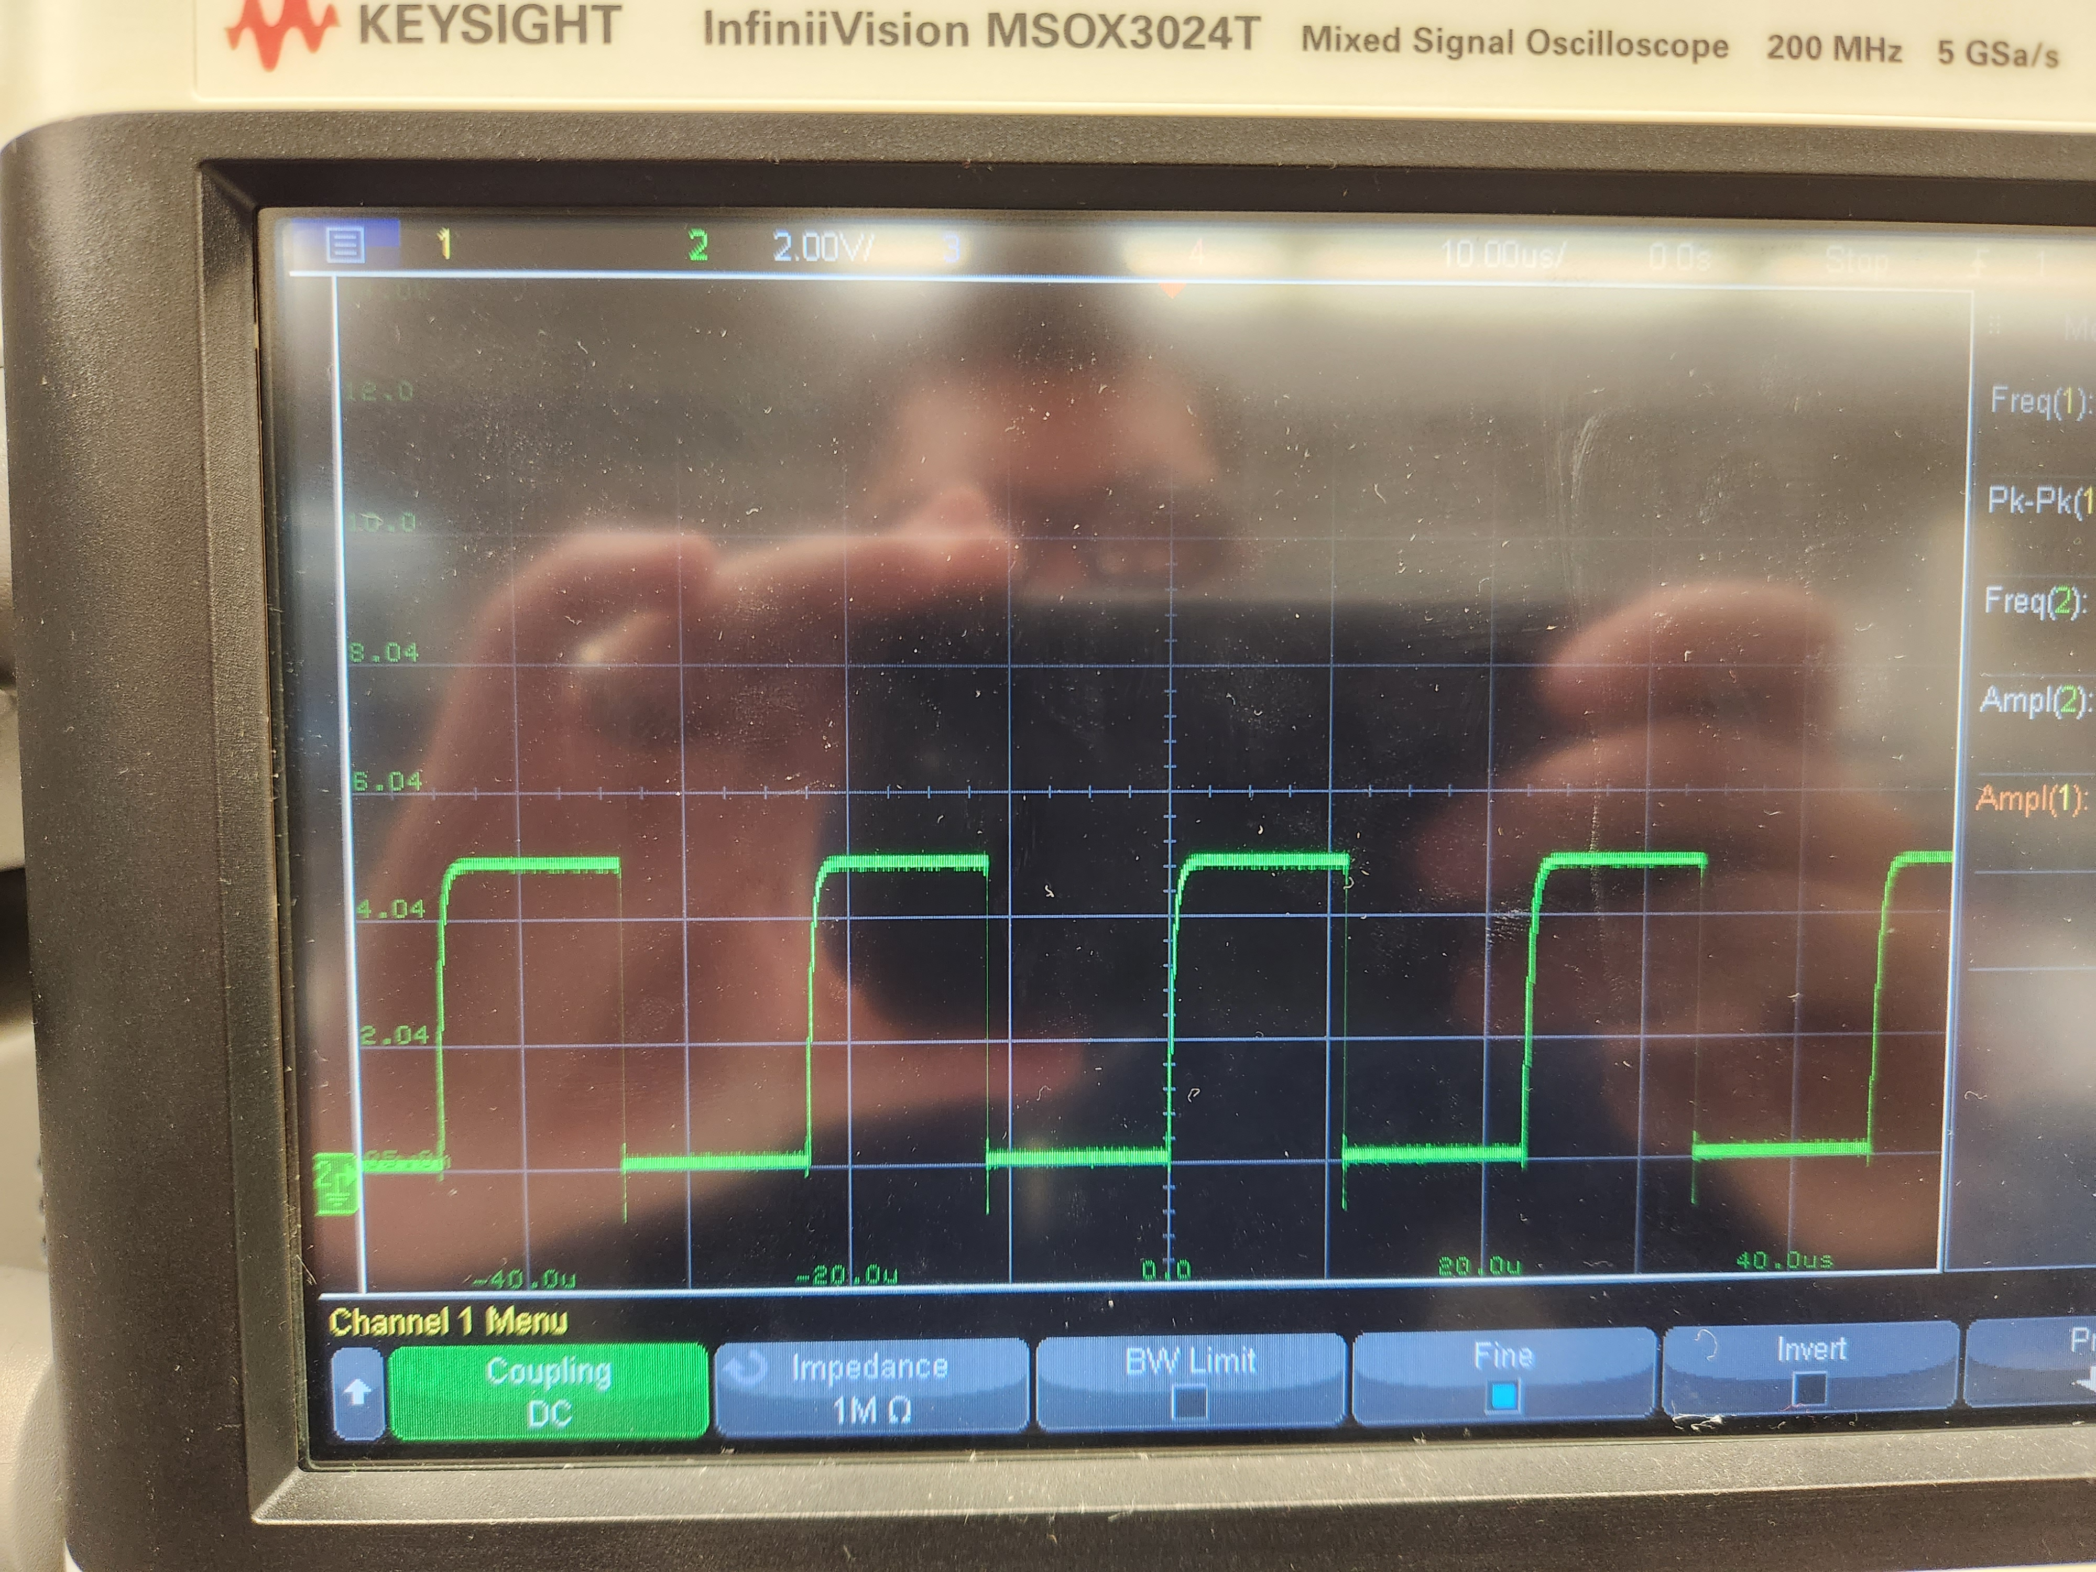
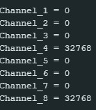
Internal Data Transfer and Manipulation
CHALLENGES
Isolator Distorts Digital Signal
Switching Speed of isolator is much lower than anticipated
Learning To code with Arduino and use SPI Library.
SOLUTIONS
Reduce Clock Frequency from 2MHz to 125kHz (Ongoing)
Same solution as 1 but the frequency is slightly higher than 1/24th the capability of the ADC.
Continuing to learn from Arduino website and forums.

Slide 8
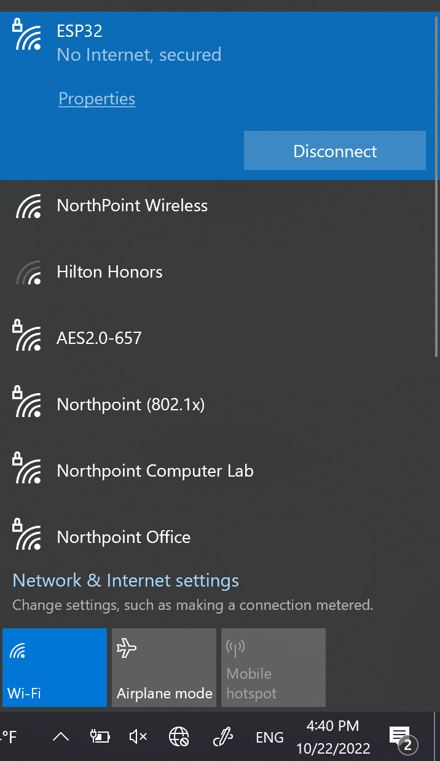

ESP32
403 Deliverables
ESP32 to connect to WiFi
UART communication for ESP32
Connect ESP32 to database
Challenges
Learning the ESP-IDE
Connection to database

Slide 9
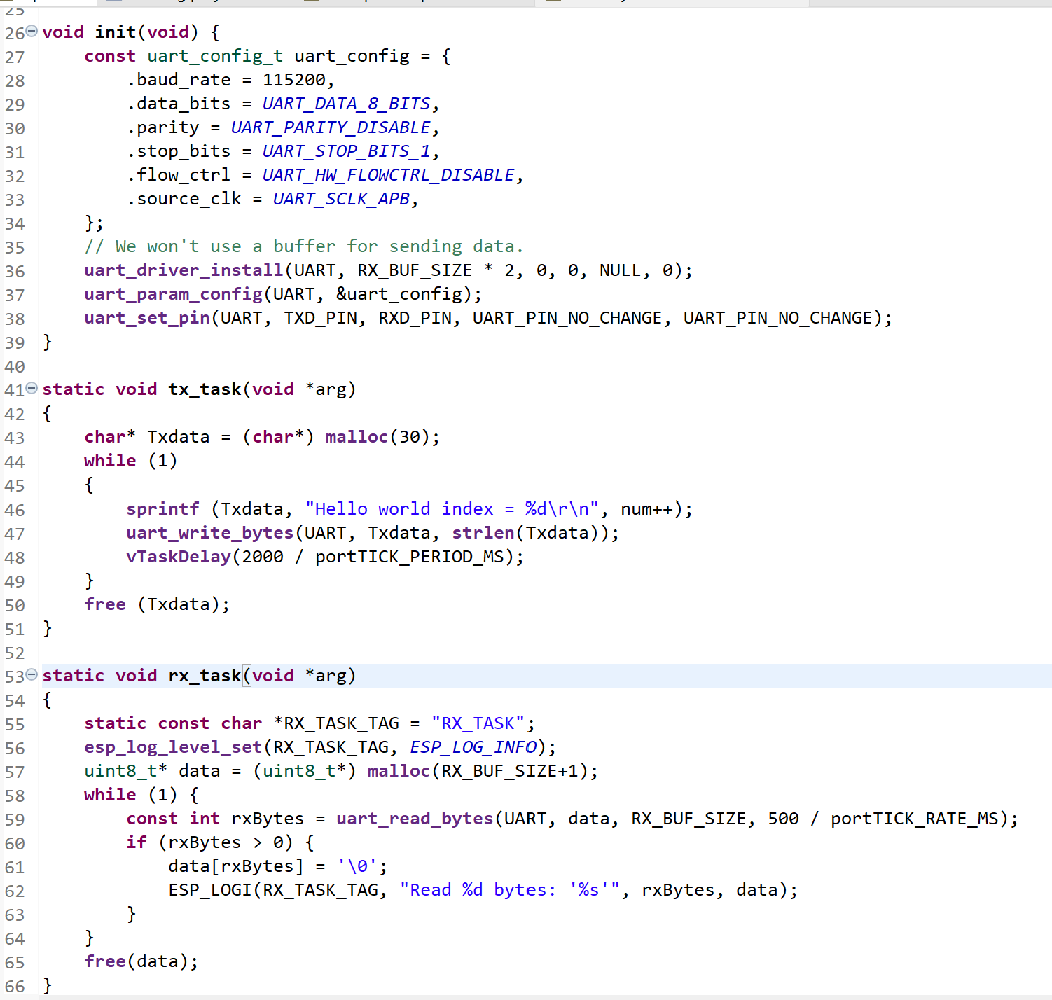
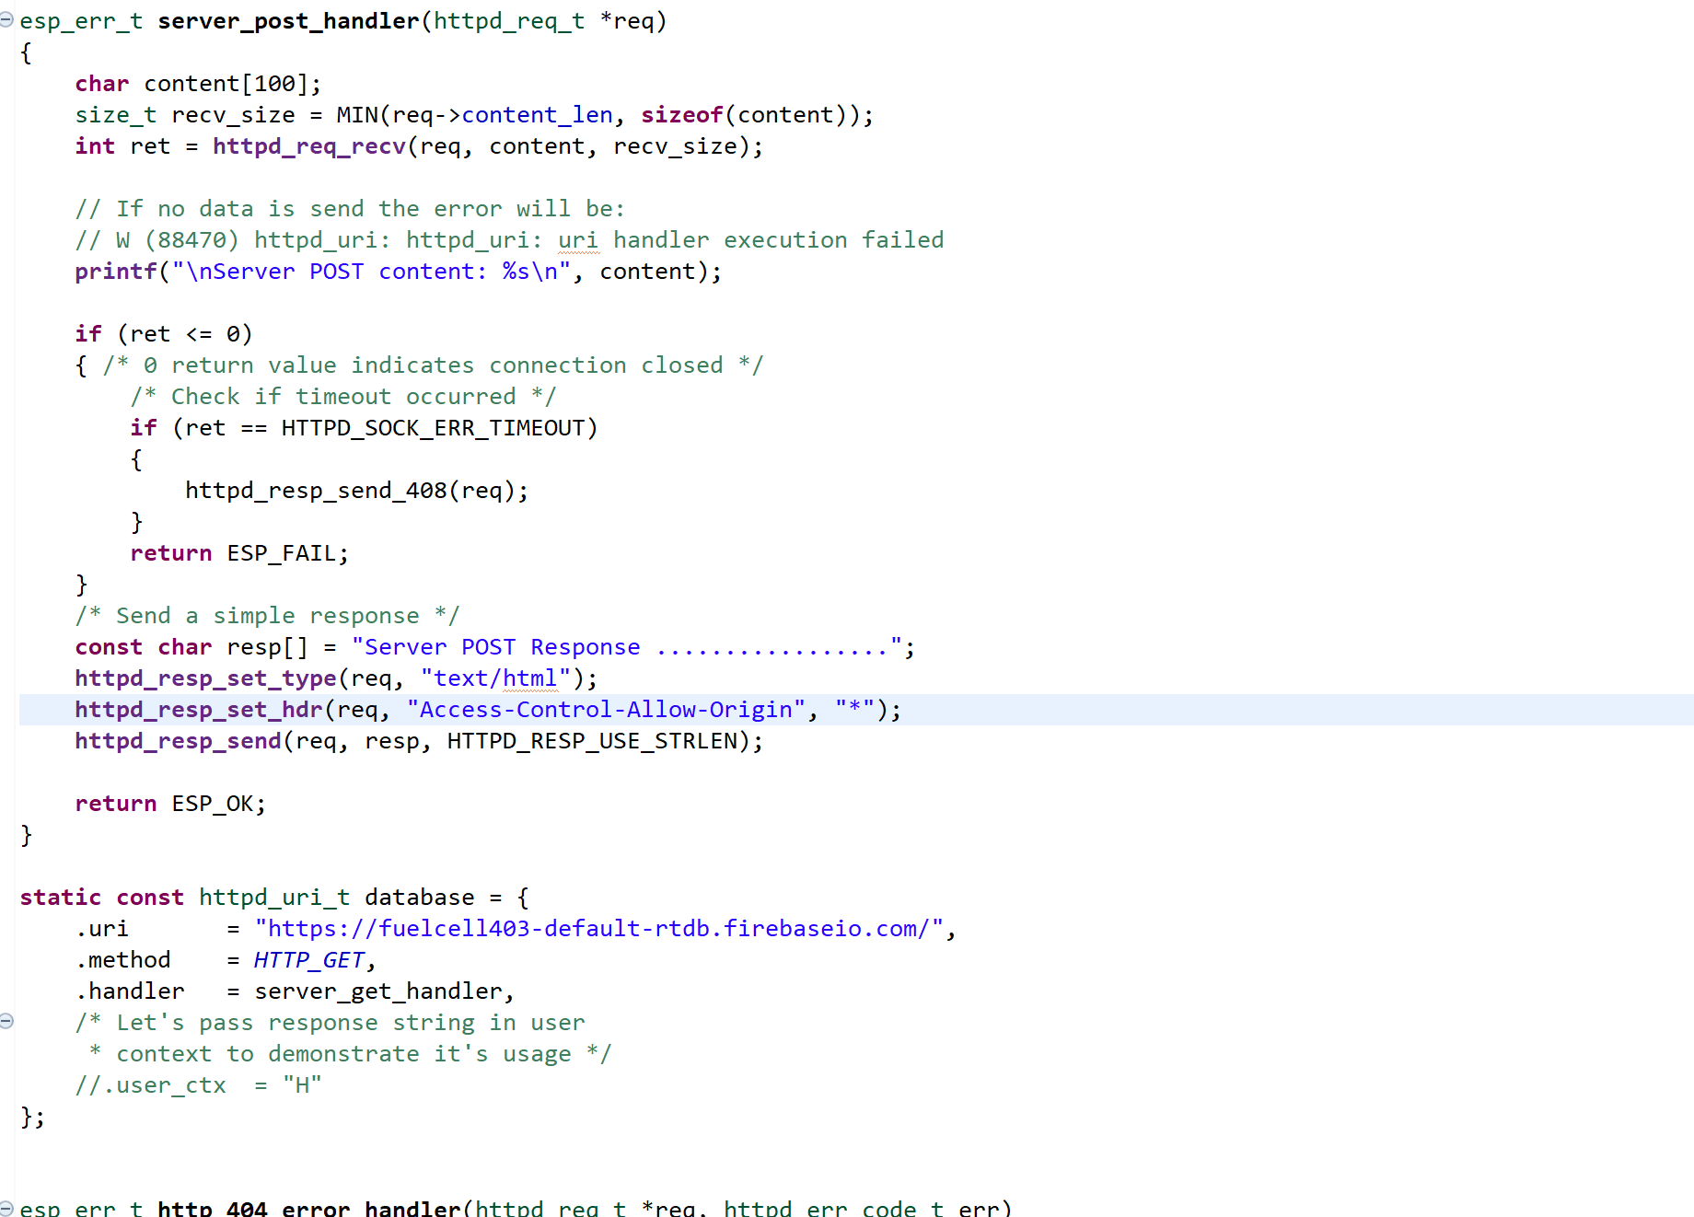
ESP32
UART Code
Database connection code

Slide 10
PIC32
403 Deliverables
UART communication
A/D converter code
Array of fuel-cell voltages
Challenges
Learning MPLAB IDE
Fried the PIC32 chip

Slide 11
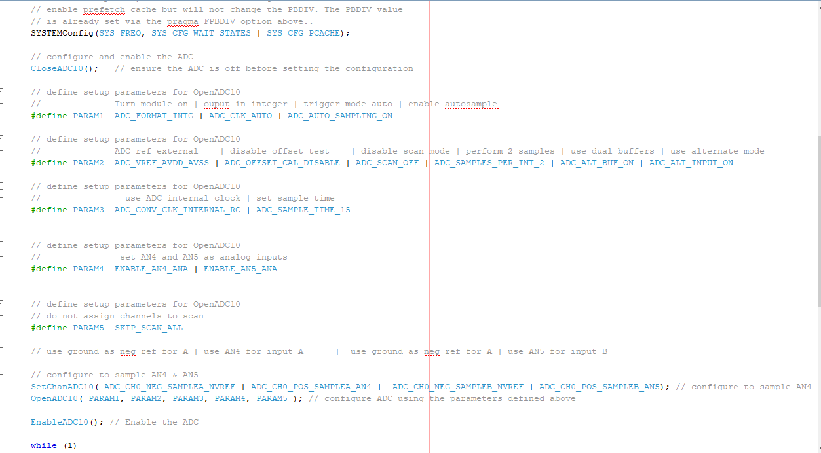
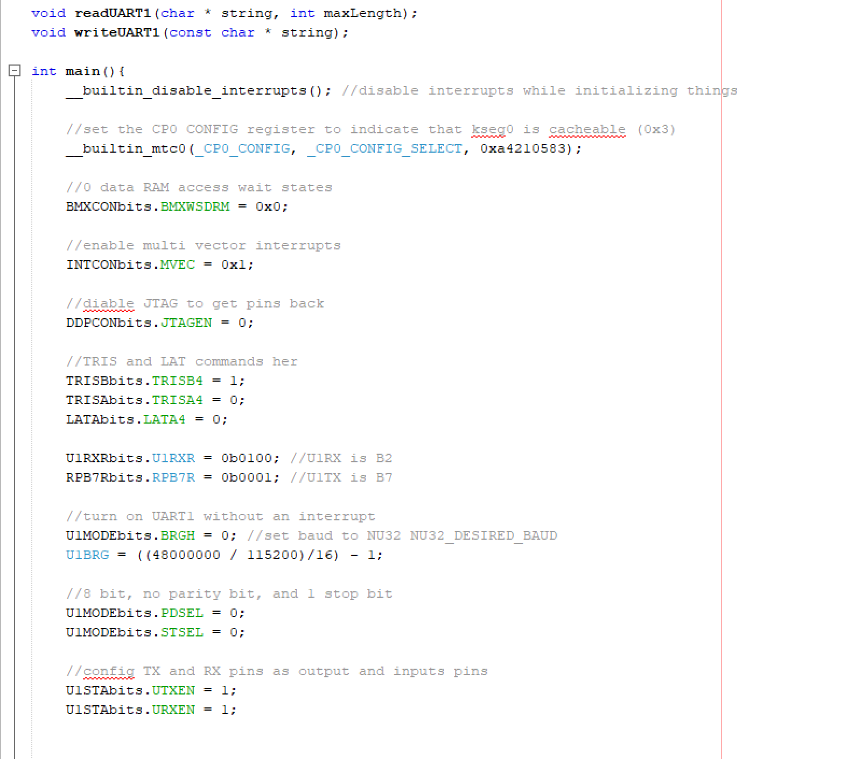
PIC32
AD Converter Code
UART Code

Slide 12
Android Application
403 Deliverables
Complete Layout of Android Application
Database Storage and Connection to App
Alert functionality for user
Challenges
Database Connection

Slide 13
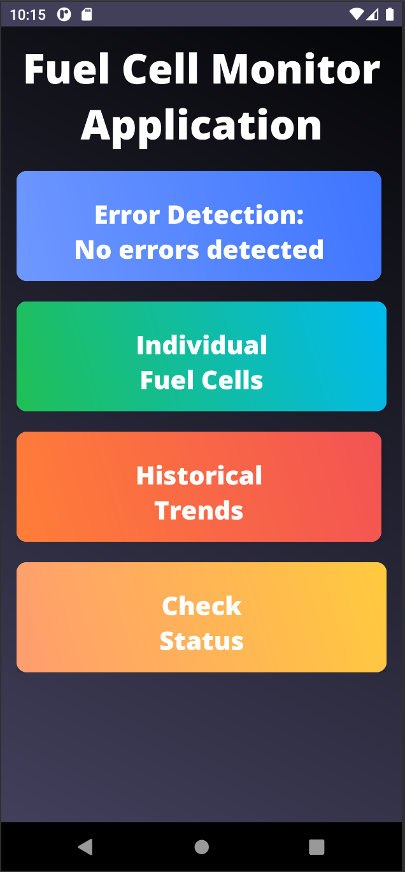
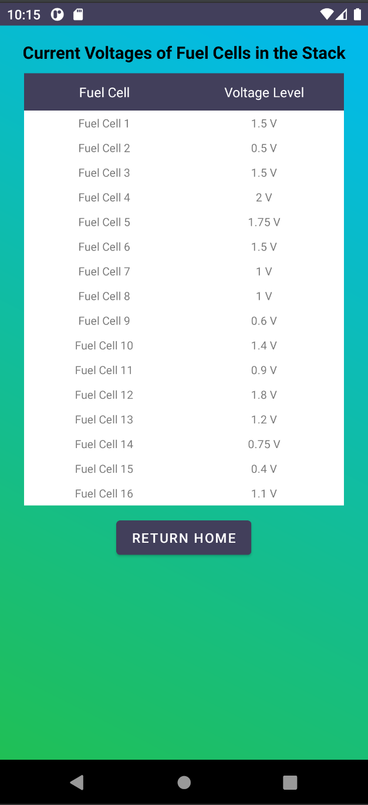
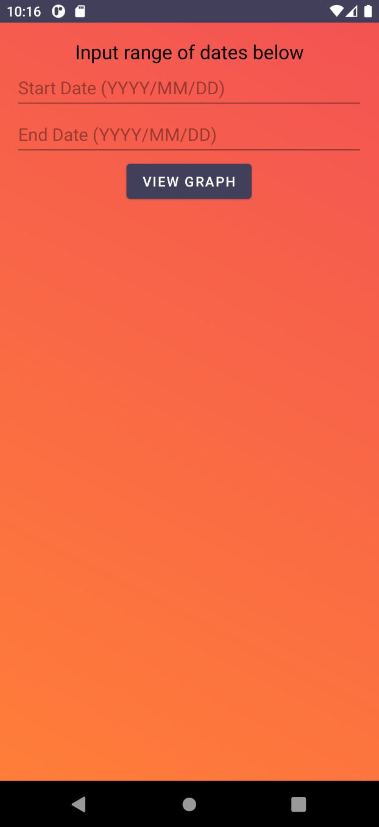
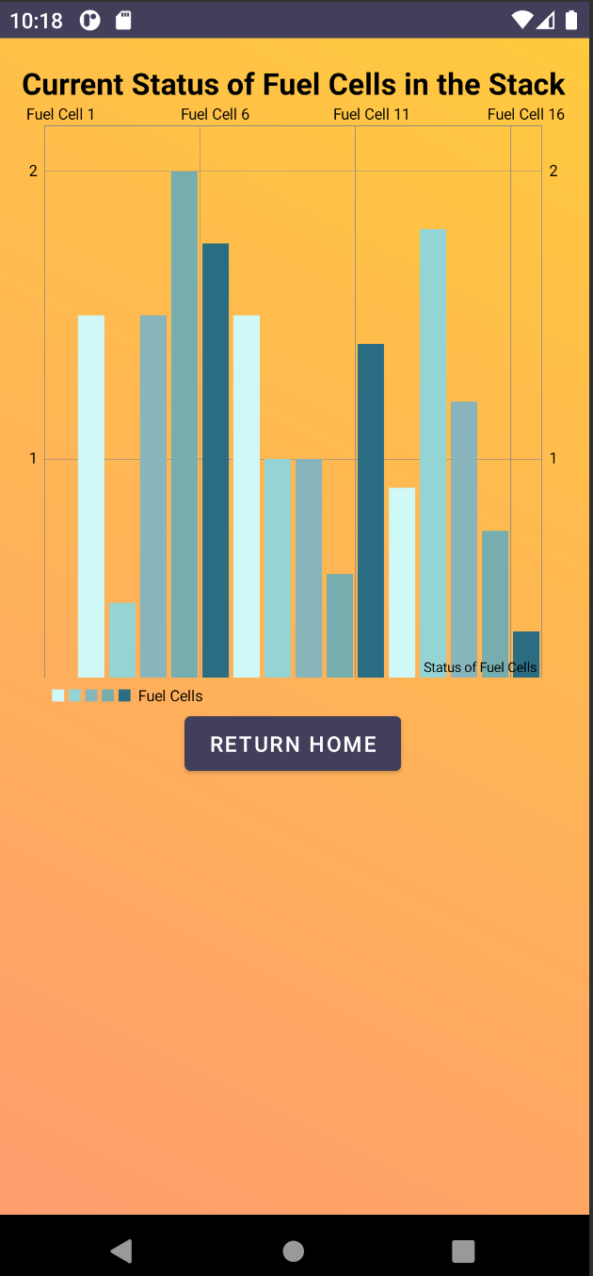
Android Application

Slide 14
Execution and Validation Status

Slide 15
Execution and Validation Status
Paragraph # | Test Name | Success Criteria | Methodology | Status | Responsible Engineer(s)
3.2.4.2 | Power Devices On PCB | PCB transfers power without overheating or burnout | Power Board and watch, smell, listen | Untested | Russell, Sameer
3.2.1.1 | Internal signal voltage range | System can properly handle the specified voltages with minimal difference between tests. | Introduce voltages of 0-4V and measure output signals | FAIL | Russell
3.2.1.1 | Differential voltage tests | Pass a differential voltage through the Opamp buffer and receive the proper digital signal from the optoisolator | Introduce a range of voltages including edge cases and ensure proper output | Untested | Russell, Sameer
3.2.4.4 | Android application graphical functionality | Application can properly display accurate voltage levels to user. | Use application on android device and verify volatages are accurately displayed | Tested | Jessica
3.2.4.4 | Android Application alarm functionality | Application send alarm to user when voltage goes above or below ranges | Add set points to app and introduce alarm level voltages | Untested | Jessica
3.2.4.2 | Power system functionality test | Power is applied from wall outlet and proper power transfer is read at outputs | Apply power to system and read voltage output at device trace | Untested | Sameer
3.2.4.1 | Opamp system functionality test | Differential voltages are passed to the opamp and expected voltage is seen on the output | Power opamps and apply varrying differential voltages and read output voltage | Untested | Sameer
N/A | PIC32 Microcontroller functionality test | The code for recieving the voltage signal for data acquisition | PCB board and coding on IDE | In progress | Rana
N/A | ESP32 Microcontroller functionality test | The code for communicating with the application | PCB board and coding on IDE | Tested | Rana

Slide 16
Remaining Tasks
Complete testing of internal signal system
Complete Microcontroller/processor PCB design
Integrate All subsystems onto a single PCB.
Final Testing and Validation of Completed Internal System.
Purchase system enclosure and assemble.

